Slide 1
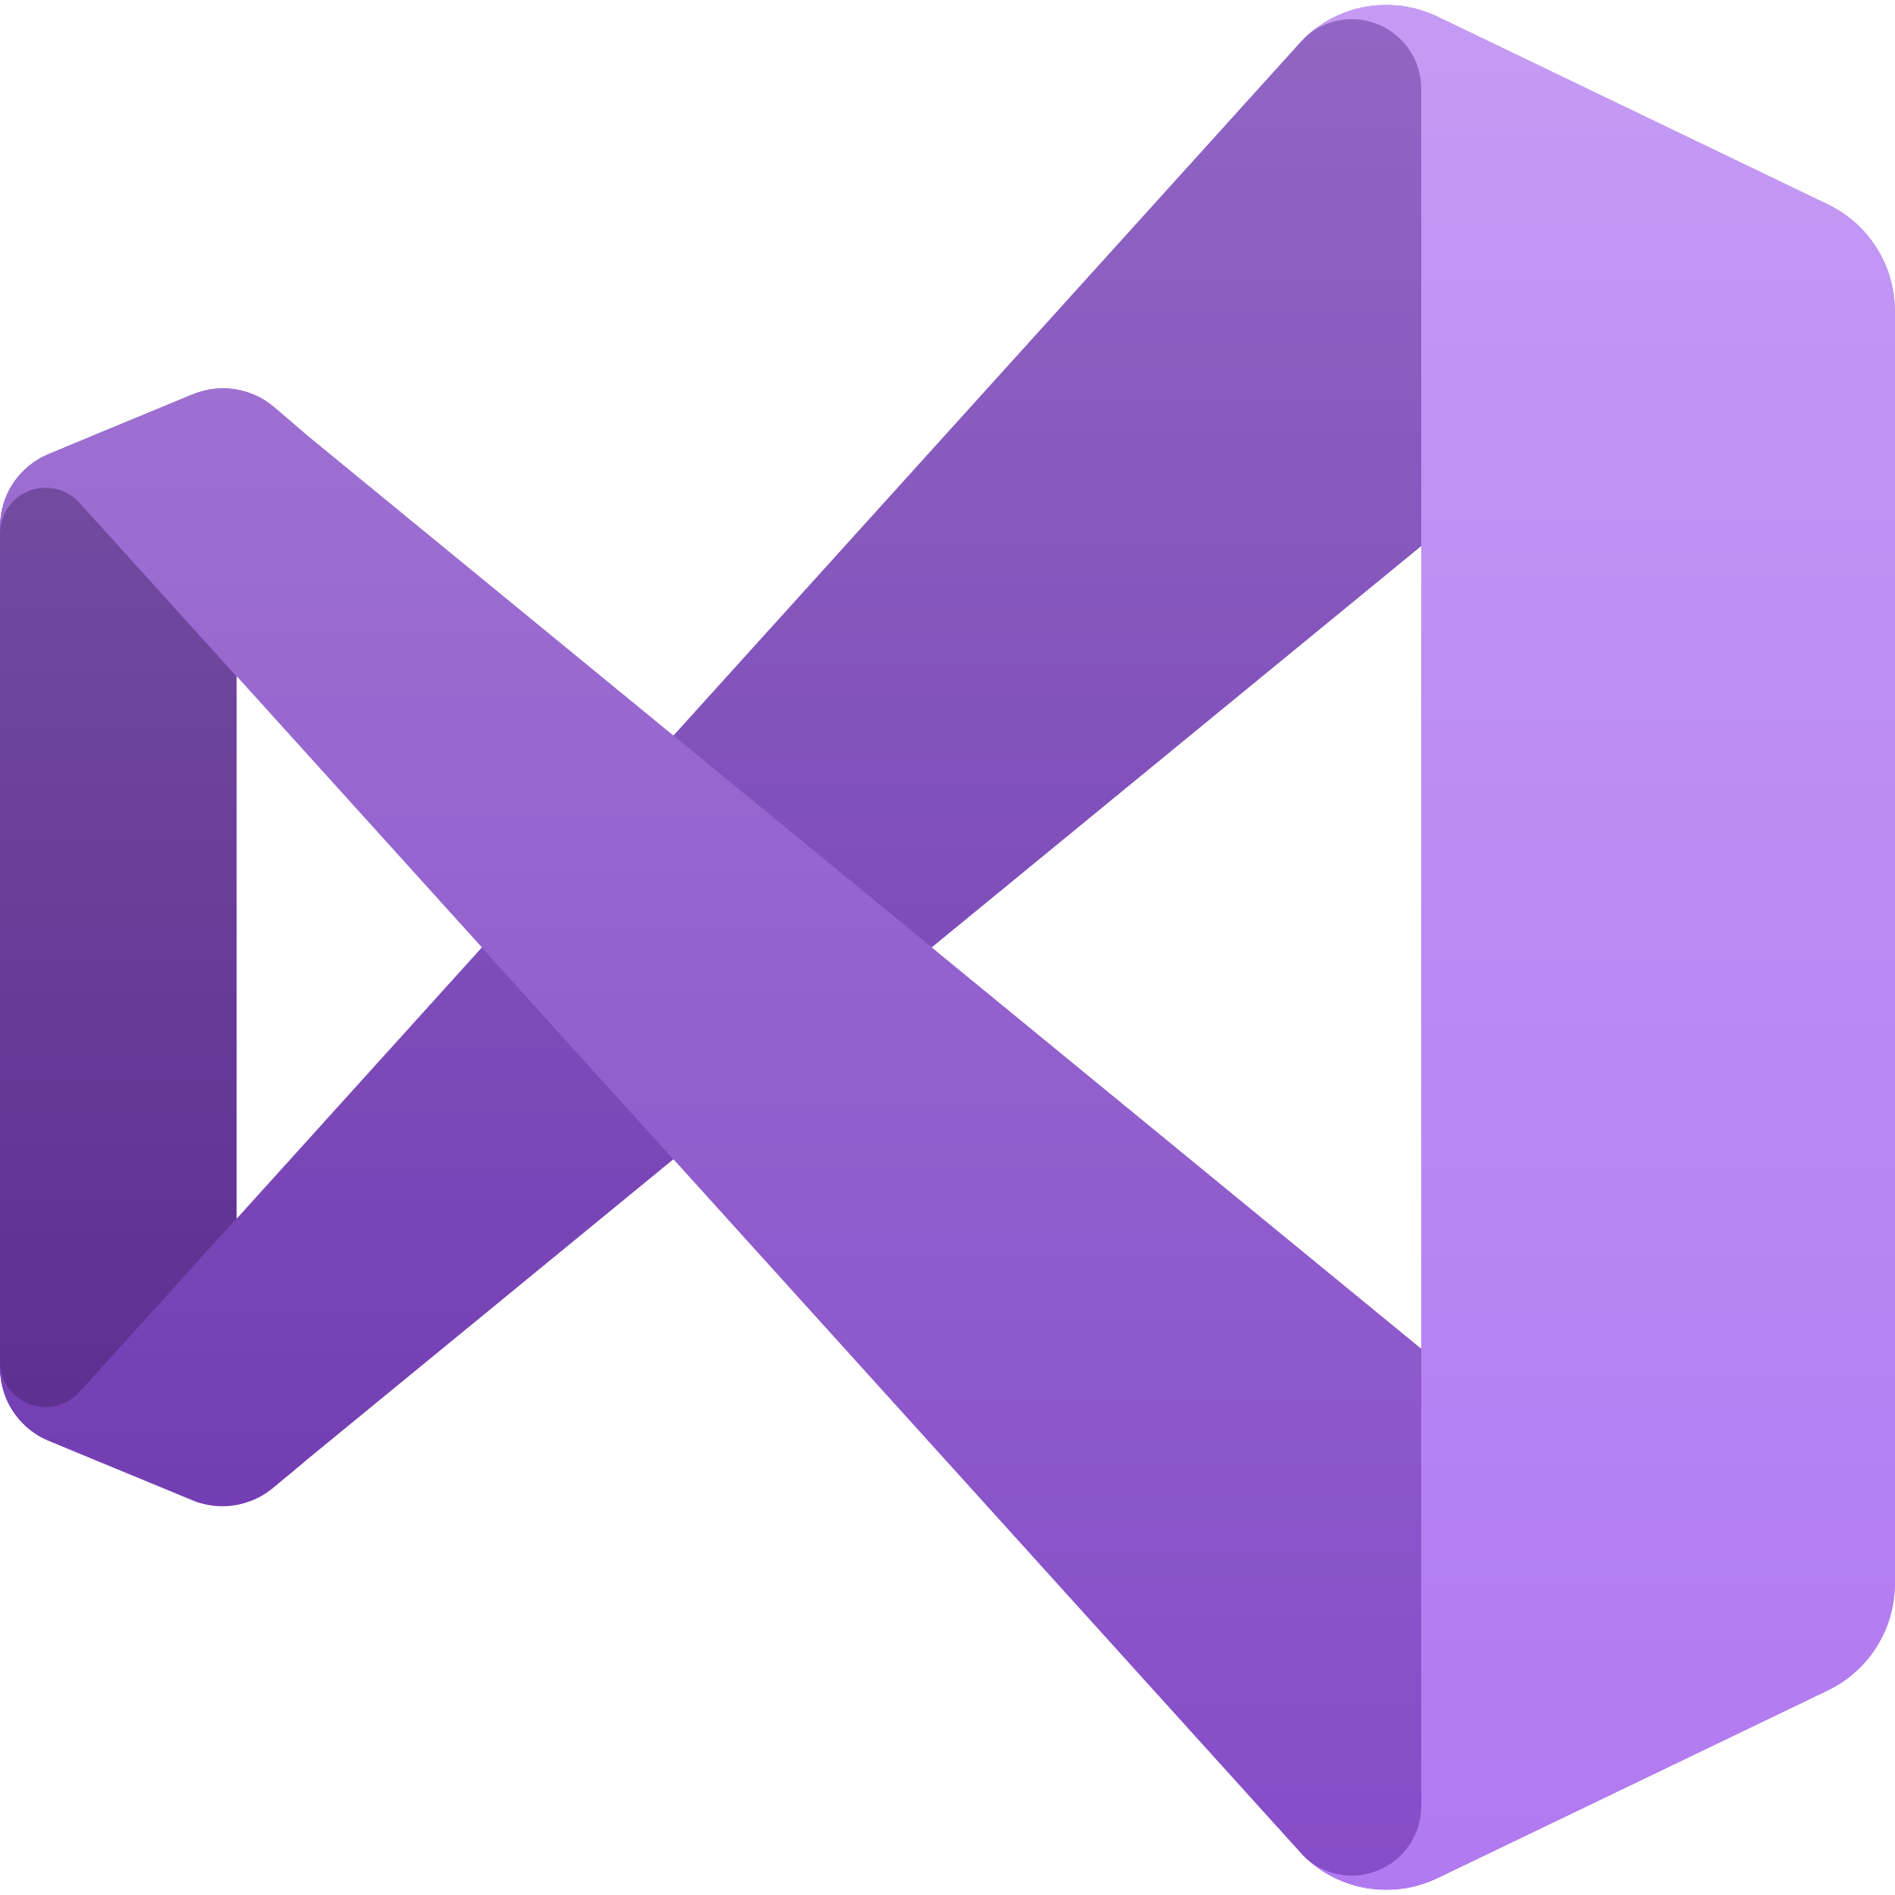
visual studio
intro to apis – class 3

Slide 2


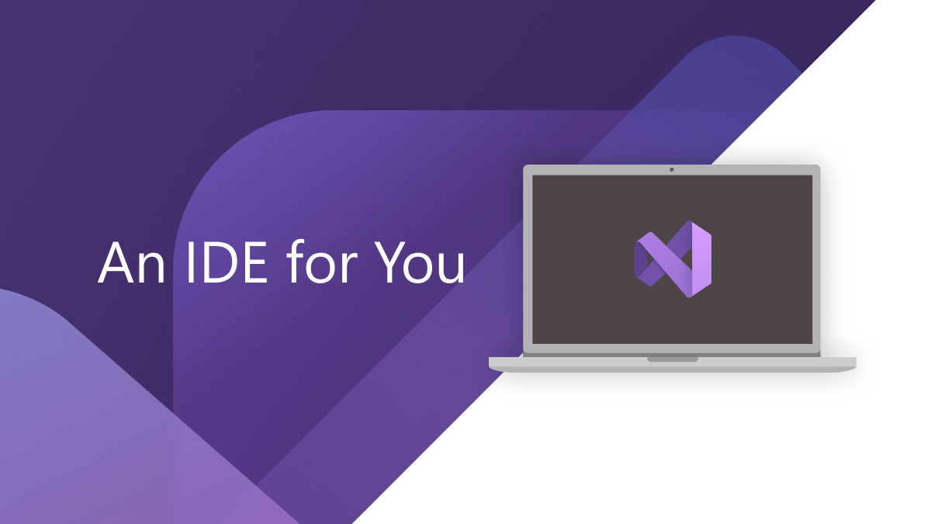
what is visual studio?
Visual Studio is an IDE (Integrated Development Environment), which is software for building applications that combines common developer tools into a single GUI.
GUI stands for Graphical User Interface– it generally uses icons, menus and a mouse (to click on the icon or pull down the menus) to manage interaction with a system. Developed by Xerox, GUIs were popularized by the Apple Macintosh in the 1980s.

Slide 3

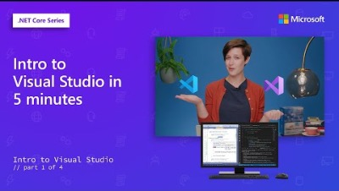

Slide 4
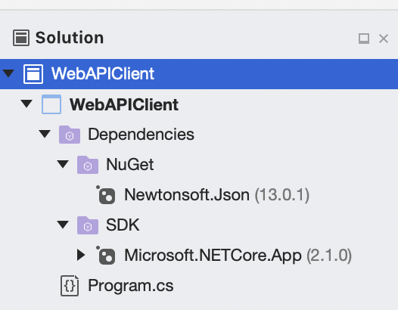
The solution explorer
Visual Studio provides a Solution Explorer window that enables you to explore and manage your solutions and projects.
Solution
Project
Project Dependencies
* This is an example of a very simple program. There can be multiple projects per solution, and many more files per project other than Program.cs!

Slide 5
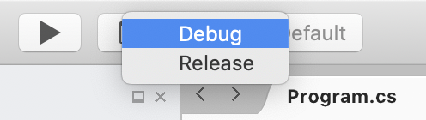
building in visual studio: release vs. debug
Visual Studio projects have separate release and debug configurations for your program. You build the debug version for debugging and the release version for the final release distribution.
In a debug build, the complete symbolic debug information is emitted when run. Code optimization is not considered.
In a release build, the symbolic debug info is not emitted and the code execution is optimized.

Slide 6
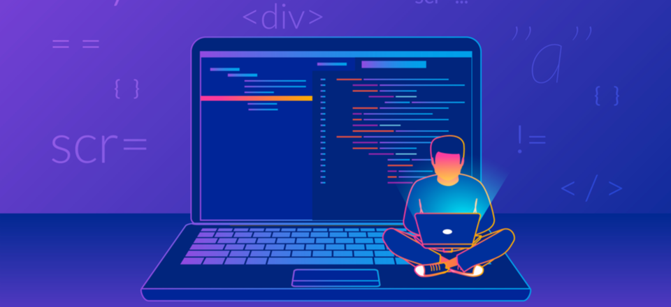
the three main parts of an ide
Source Code Editor: Text editing tool designed specifically for the source code of computer programs.
Build Automation Tools: Incorporates compiling, linking and packaging the code into a usable or executable form.
Compiling is the transformation from source code (human-readable) into machine code (computer-executable).
Linking is is the process of collecting and combining various pieces of code and data from different files into a single file (which would be the executable) that can be loaded into memory and executed.
Debugger: Runs the target program under controlled conditions that permit the programmer to track its operations in progress and monitor changes in computer resources that may indicate malfunctioning code.

Slide 7
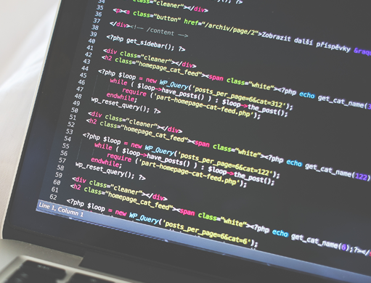
the source code editor
A source code editor may be a stand-alone program or part of an IDE. They make writing and reading the source code easier by differentiating the elements and routines so programmers can more easily look at their code.
Source code editors have features specifically designed to simplify and speed up the typing of source code, such as syntax highlighting, indentation, autocomplete and brace-matching functionality.
While many text editors (like Notepad) can be used to edit source code, if they don't enhance, automate or ease the editing of code, they are not source-code editors.

Slide 8
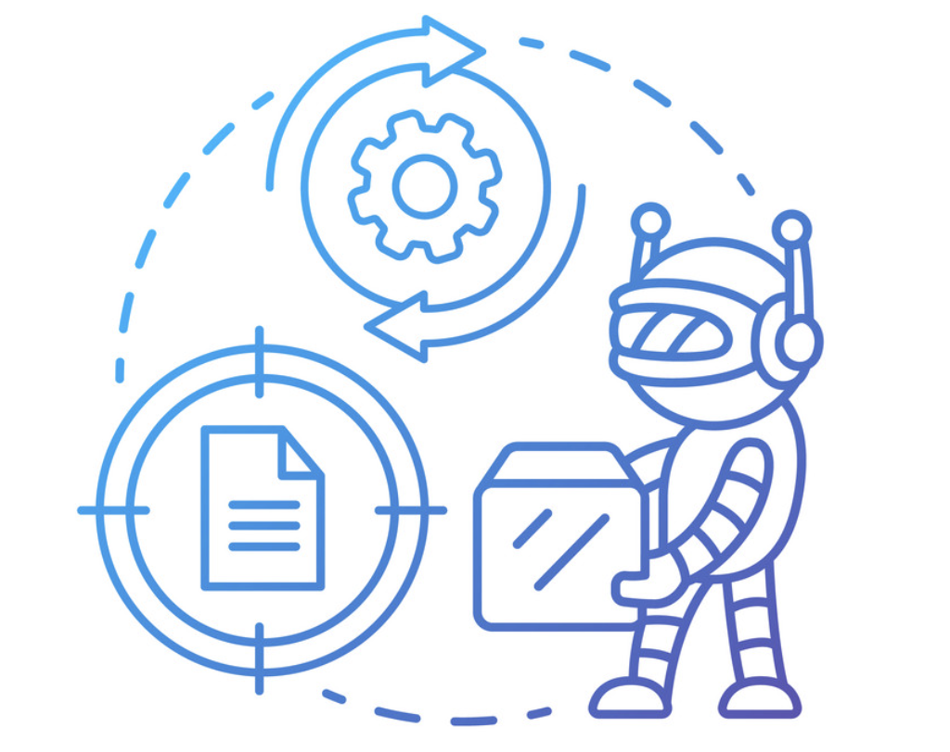
what is build automation / automated build?
In the context of software development, “build” refers to the process that converts files and other assets under the developers’ responsibility into a software product in its final or consumable form. The build may include:
Compiling source files
Packaging compiled files into compressed formats
And a lot more!
The build is automated when these steps are repeatable, require no direct human intervention, and can be performed at any time with no information other than what is stored in the source code control repository.

Slide 9

about debugging
Debuggers allow users to halt the execution of the program, examine the values of variables, step through program line by line, and so on.
Debugging is not always about finding problems in the code. It can also be used to simply learn how code runs so a developer gains a thorough understanding of it before they refactor or enhance the code with new functionality. This form of debugging is typically called dynamic analysis.

Slide 10
types of debugging
Interactive Debugging
Reverse Debugging
Remote Debugging
Post-Mortem Debugging
Delta Debugging
Batch Debugging

Slide 11
types of debugging
Interactive Debugging: The most common debugging technique is interactive debugging. In this process, you’ve loaded your program with the debugger’s GUI and analyze the running program by stepping through code, setting break points, examining program data, and looking at how it's running.

Slide 12
types of debugging
Reverse Debugging: Advanced debuggers allow users to record the execution of a program and step through code in reverse.

Slide 13
types of debugging
Remote Debugging: With remote debugging, you are debugging an application that is deployed on a different computer from a remote location. This could be anywhere — the other side of the lab, the other side of your campus, or even across the country or world. A debugger needs the capabilities to be able to debug remotely on that type of system.

Slide 14
types of debugging
Post-Mortem Debugging: Post-mortem debugging is a technique where you've gathered information during a run, and then your program crashes. In this scenario, you want to gather as much information as you can so it can be analyzed later to diagnose what happened during the run of your program.

Slide 15
types of debugging
Delta Debugging: Also called comparative debugging, this is a way of comparing one run to another, or two programs running side-by-side and looking for ways that they differ in their execution of the lines that they're going through, or the ways that their data differs between the two.

Slide 16
types of debugging
Batch Debugging: This may also be referred to as unintended debugging. In this scenario, the debugger is still in control of your program even while you're not sitting in front of a GUI. The debugger is driving the program through to completion and along the way it will save that information, so that a post-mortem debugging can be performed later.

Slide 17
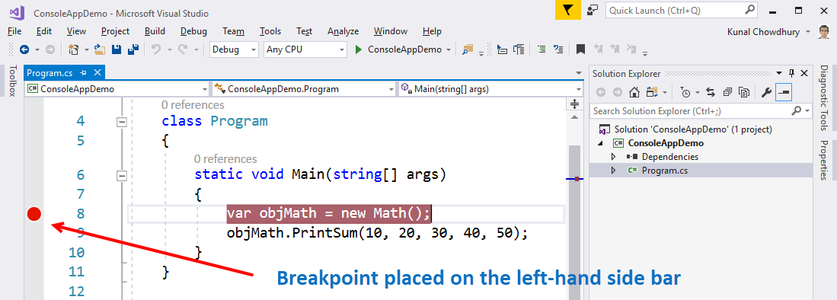
breakpoints
A breakpoint is an intentional pause in a program, put in place for debugging purposes. (It is also sometimes simply referred to as a pause.)
When hit, breakpoints will halt execution of the program at that spot/line. At this point, the user can discover how a program flows, identify incorrect code and data, and find semantic errors in the program.

Slide 18
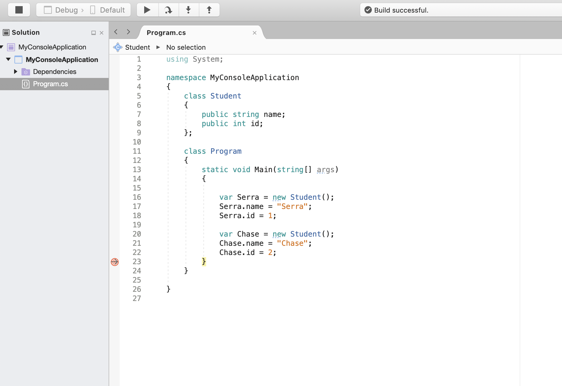
breakpoint example

Slide 19
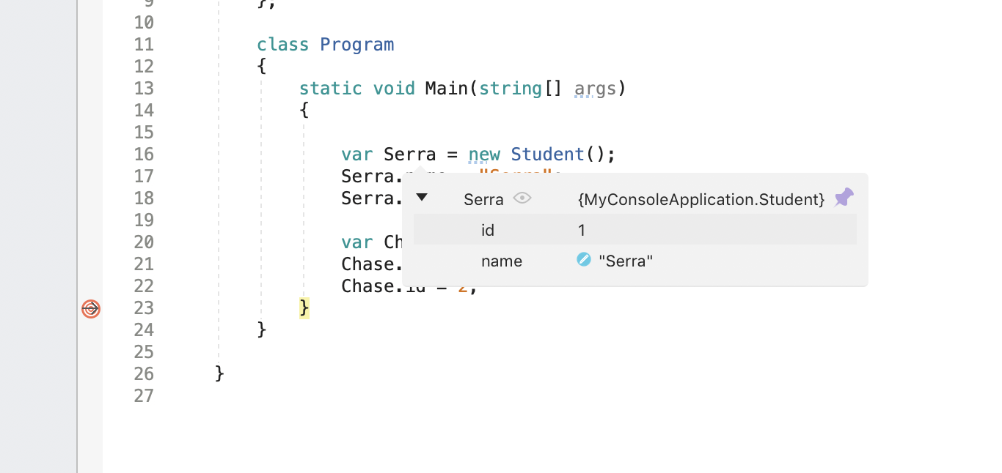
breakpoint example

Slide 20
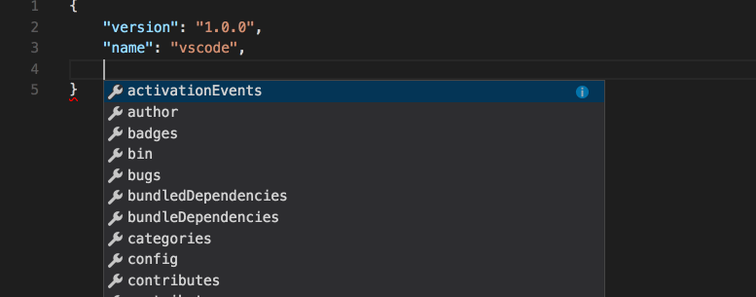
intellisense
IntelliSense is a code-completion aid that includes a number of features: List Members, Parameter Info, Quick Info, and Complete Word. These features help you to learn more about the code you're using, keep track of the parameters you're typing, and add calls to properties and methods with only a few keystrokes.

Slide 21
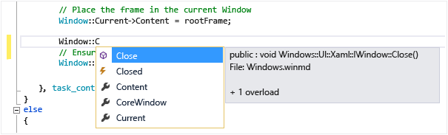
intellisense – List Members
A list of valid members from a type (or namespace) appears after you type a trigger character (for example, a period (.) in managed code or :: in C++). If you continue typing characters, the list is filtered to include only the members that begin with those characters or where the beginning of any word within the name starts with those characters. IntelliSense also performs "camel case" matching, so you can just type the first letter of each camel-cased word in the member name to see the matches.

Slide 22
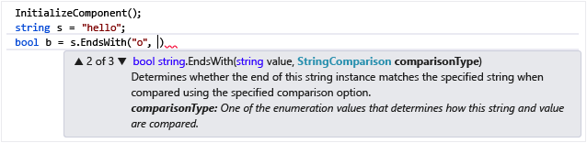
intellisense – Parameter info
Parameter Info gives you information about the number, names, and types of parameters required by a method, attribute generic type parameter (in C#), or template (in C++).
The parameter in bold indicates the next parameter that is required as you type the function. For overloaded functions, you can use the Up and Down arrow keys to view alternative parameter information for the function overloads.

Slide 23
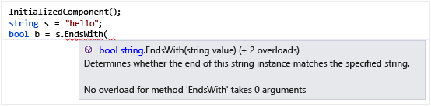
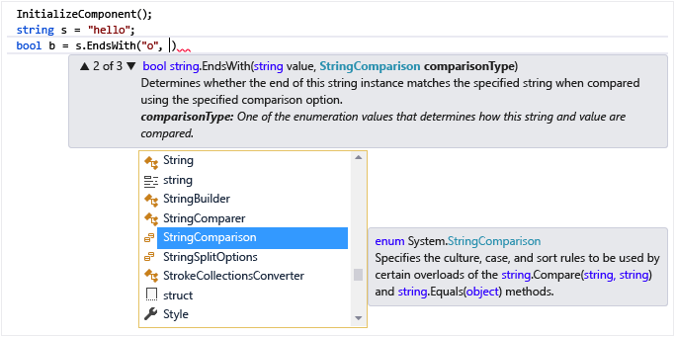
intellisense – quick info
Quick Info displays the complete declaration for any identifier in your code.
When you select a member from the List Members box, further Quick Info appears.

Slide 24
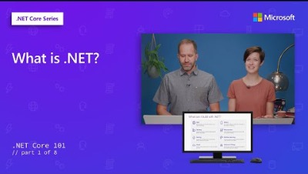

Slide 25
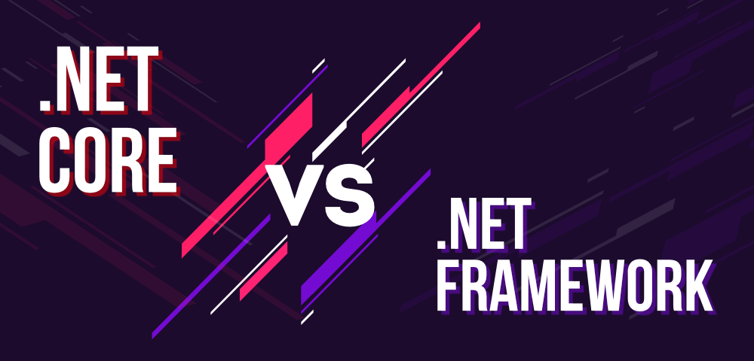
.NET (framework) vs. .net core
.NET is a software framework that is designed and developed by Microsoft. The first version of the .NET framework was 1.0 which came in the year 2002. It is a used for compiling and executing programs written in different languages. It is used to develop form-based applications, web-based applications, and web services. There is a variety of programming languages available on the .NET platform– VB.NET and C# being the most common ones.
A framework, or software framework, is a platform that provides a foundation for developing software applications. Think of it as a template of a working program that can be selectively modified by adding code. It uses shared resources – such as libraries, image files, and reference documents, to provide functionality to the developer as they make a product.
.NET Core is a free open source, a general-purpose development platform for developing modern cloud-based software applications on Windows, Linux, and macOS operating systems. It operates across several platforms and has been revamped to make .NET fast, scalable, and modern. .NET Core is one of Microsoft’s biggest contributions.
A development platform is similar to a framework, but can be used with other tools to build an app, while frameworks are only used for design/development, and not for hosting/running the application.

Slide 26
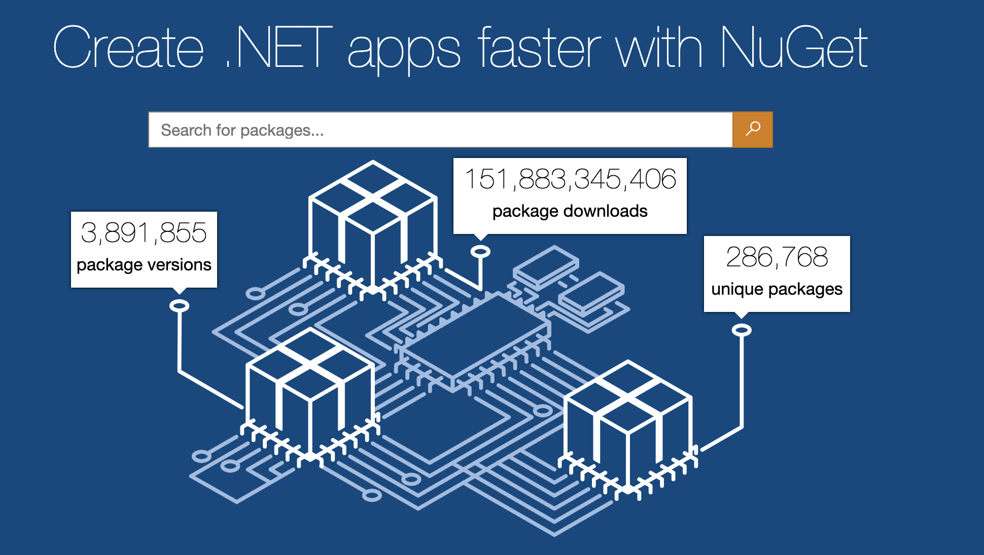
NuGet
NuGet is the package manager for .NET. The NuGet client tools provide the ability to produce and consume packages (like certain frameworks!). The NuGet Gallery is the central package repository used by all package authors and consumers.
A client is a computer or a program that, as part of its operation, relies on sending a request to another program or a computer hardware or software that accesses a service made available by a server (which may or may not be located on another computer).

Slide 27

NuGet packages
A NuGet package is a single ZIP file with the .nupkg extension that contains compiled code (DLLs), other files related to that code, and a descriptive manifest that includes information like the package's version number.
Developers with code to share create packages and publish them to a public or private host.
Package consumers obtain those packages from suitable hosts, add them to their projects, and then call a package's functionality in their project code. NuGet itself then handles the intermediate details.
A DLL file, short for Dynamic Link Library, is a type of file that contains instructions that other programs can call upon to do certain things– it contains compiled code, not source code. Unlike executable programs, like those with the EXE file extension, DLL files can't be run directly but instead must be called upon by other code that is already running.

Slide 28

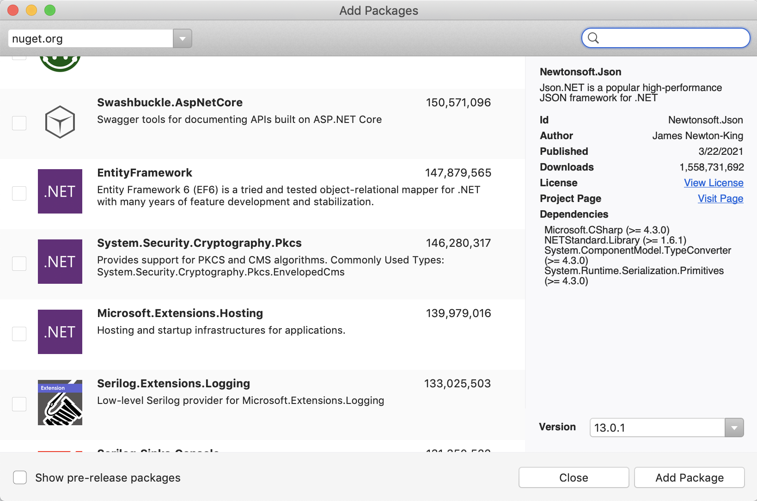
NuGet packages example

Slide 29

visual studio extensions
Extensions are add-ons that allow you to customize and enhance your experience in Visual Studio by adding new features or integrating existing tools. An extension can range in all levels of complexity, but its main purpose is to increase your productivity and cater to your workflow.
You can browse through thousands of extensions available in the Marketplace to find the tools you need. You can also publish your own extensions to the Marketplace.
While NuGet packages are project-specific and travel through source control to your colleagues, an installed extension works in all your own solutions/projects and doesn't get shared.

Slide 30
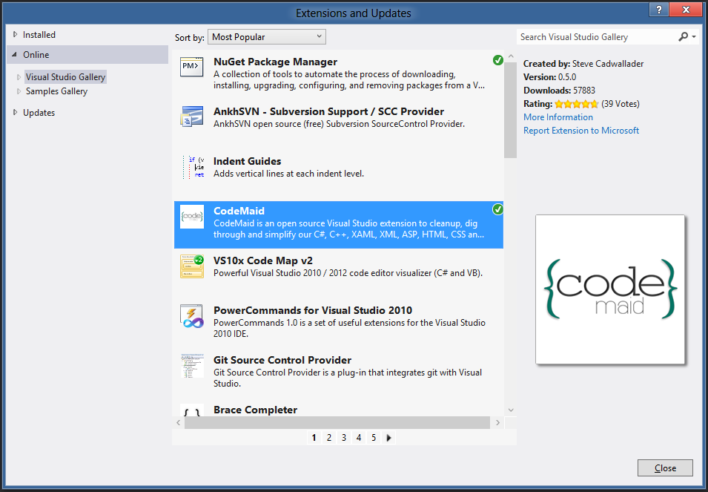
visual studio extensions example

Slide 31
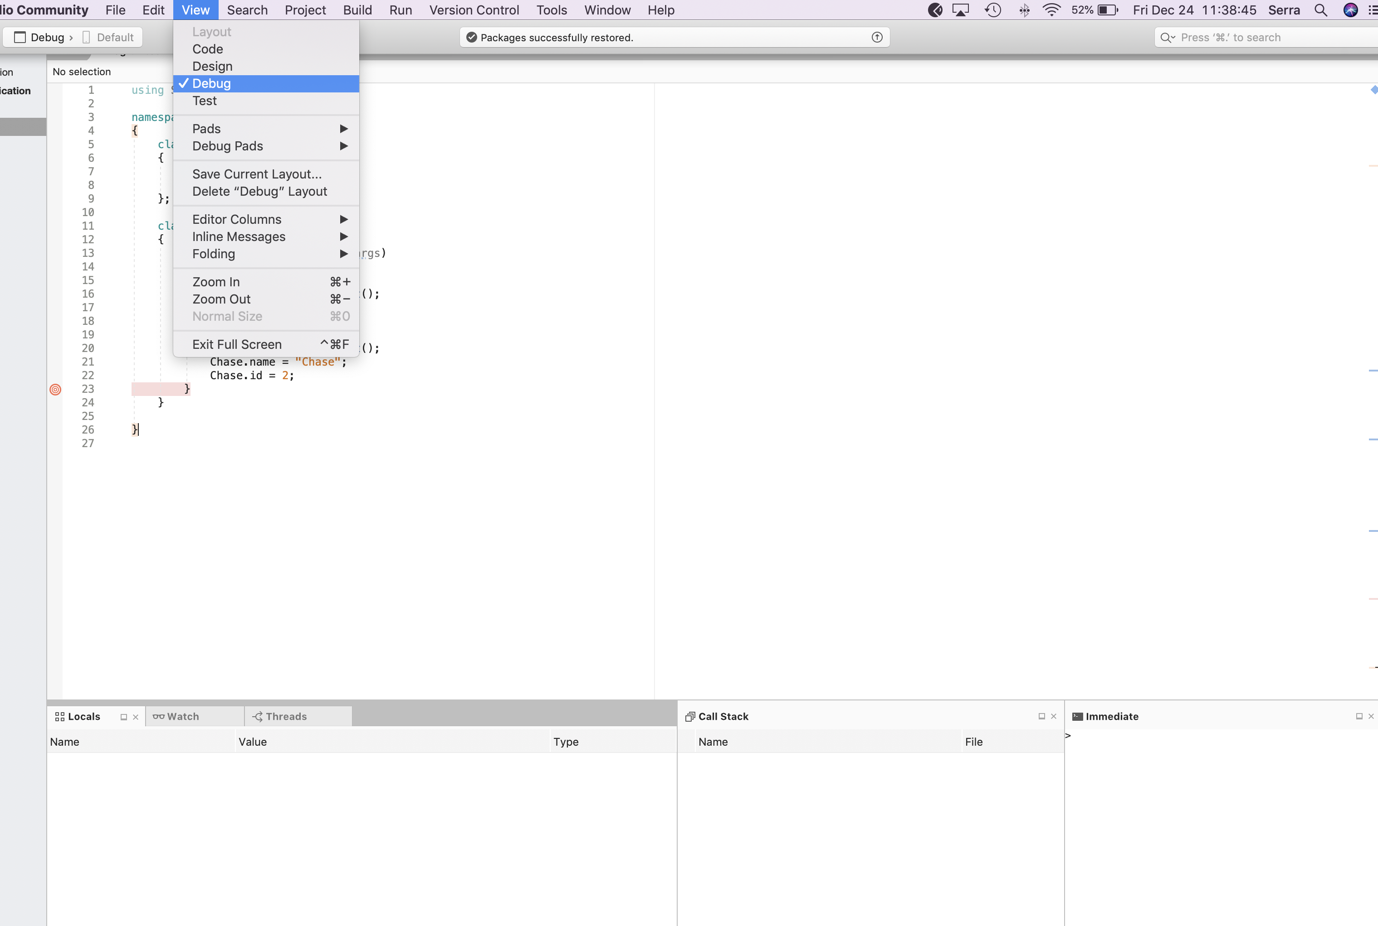

Slide 32
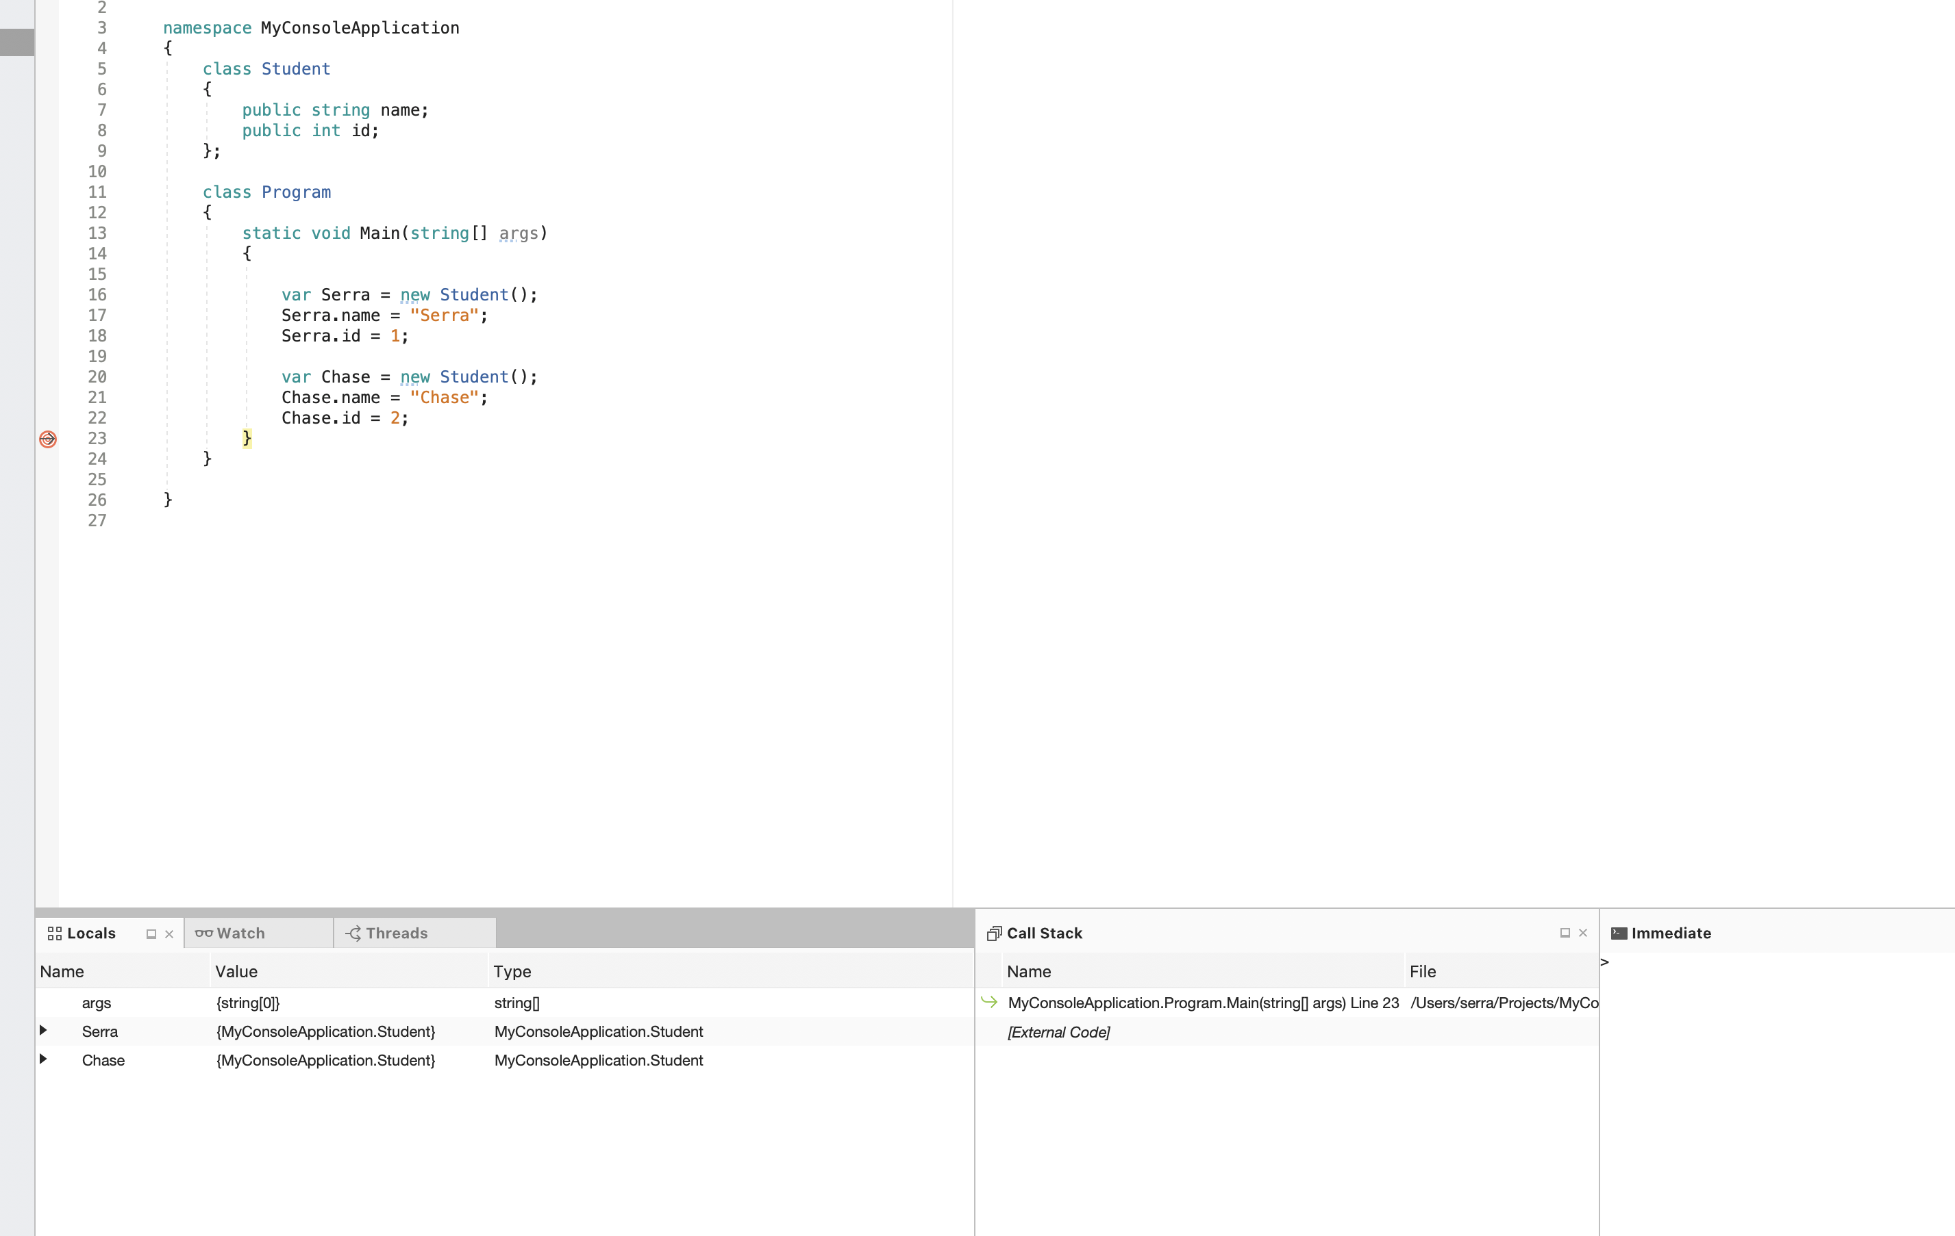

Slide 33
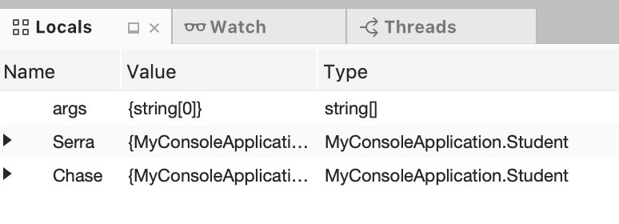
The locals window
The Locals window displays the information of the local variables and objects based on the current thread execution context.

Slide 34
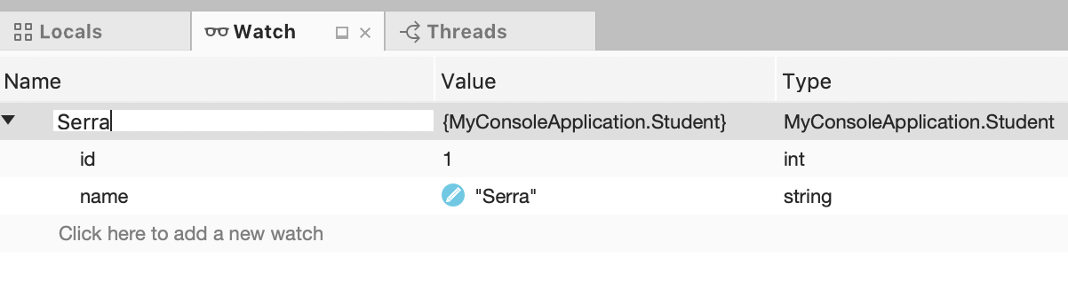
The watch window
The Watch window shows us the values of variables and expressions at each debugging step. With this helpful debugging tool we can track (or watch) specific expressions we’re interested in.

Slide 35
The threads window
The Threads window contains a table where each row describes a separate thread in your application. By default, the table lists all the threads in your application, but you can filter the list to show only the threads that interest you.
A thread is a path of execution within a process. A process can contain multiple threads. This is called multithreading.

Slide 36
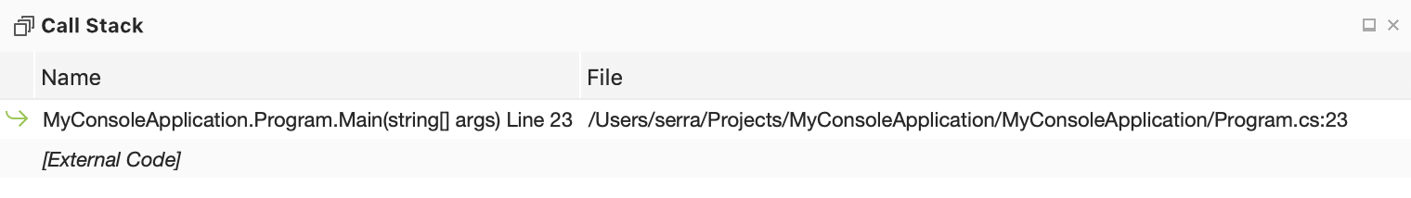
The call stack window
The call stack is a list of all the active functions that have been called to get to the current point of execution.
In the Call Stack window, each time you call a method, an entry is placed on the "stack” for that thread describing the method and the parameters used to call the method. When the method returns, the method and its parameters are removed from the stack.

Slide 37
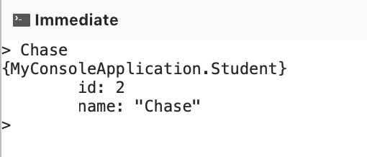
The immediate window
The Immediate window displays information resulting from debugging statements in your code or from commands typed directly into the window.

Slide 38

Activity # 3
Clone my Repository 1 project (look at slides from last class!). It can be found here: https://github.com/SerraCanca/Repository1
Open in Visual Studio.
Create a new student with your first name in the Main method, start the debugging build, hit a breakpoint after the student is created and its properties are filled in, then get a screenshot of the student’s properties in the Locals window and send it over!

